Slide 1

AMSTer : SAR & InSAR Automated Mass processing Software for Multidimensional Time series
Nicolas d’Oreye^{1,2}, Dominique Derauw^{3,4}, Sergey Samsonov⁵,
Delphine Smittarello¹, Maxime Jaspard¹, Gilles Celli¹
ndo@ecgs.lu
amster@ecgs.lu
1 European Centre for Geodynamics and Seismology (ECGS), 19 rue Josy Welter, L-7256 Walferdange, Luxembourg
2 National Museum of Natural History (NMNH), 19 rue Josy Welter, L-7256 Walferdange, Luxembourg
3 Centre Spatial de Liège (CSL), Avenue du Pré Aily, B-4031 Angleur, Belgium
4 SAREOS, 1 Rue des Violettes, 4557 Fraiture, Belgium
5 Canada Centre for Mapping and Earth Observation, Natural Resources Canada (NRCAN), 560 Rochester Street, Ottawa, ON K1A 0E4, Canada

Slide 2
Summer School in InSAR, time series processing and deformation modelling
Time Series plotting
Nicolas d’Oreye

Slide 3
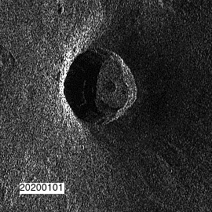

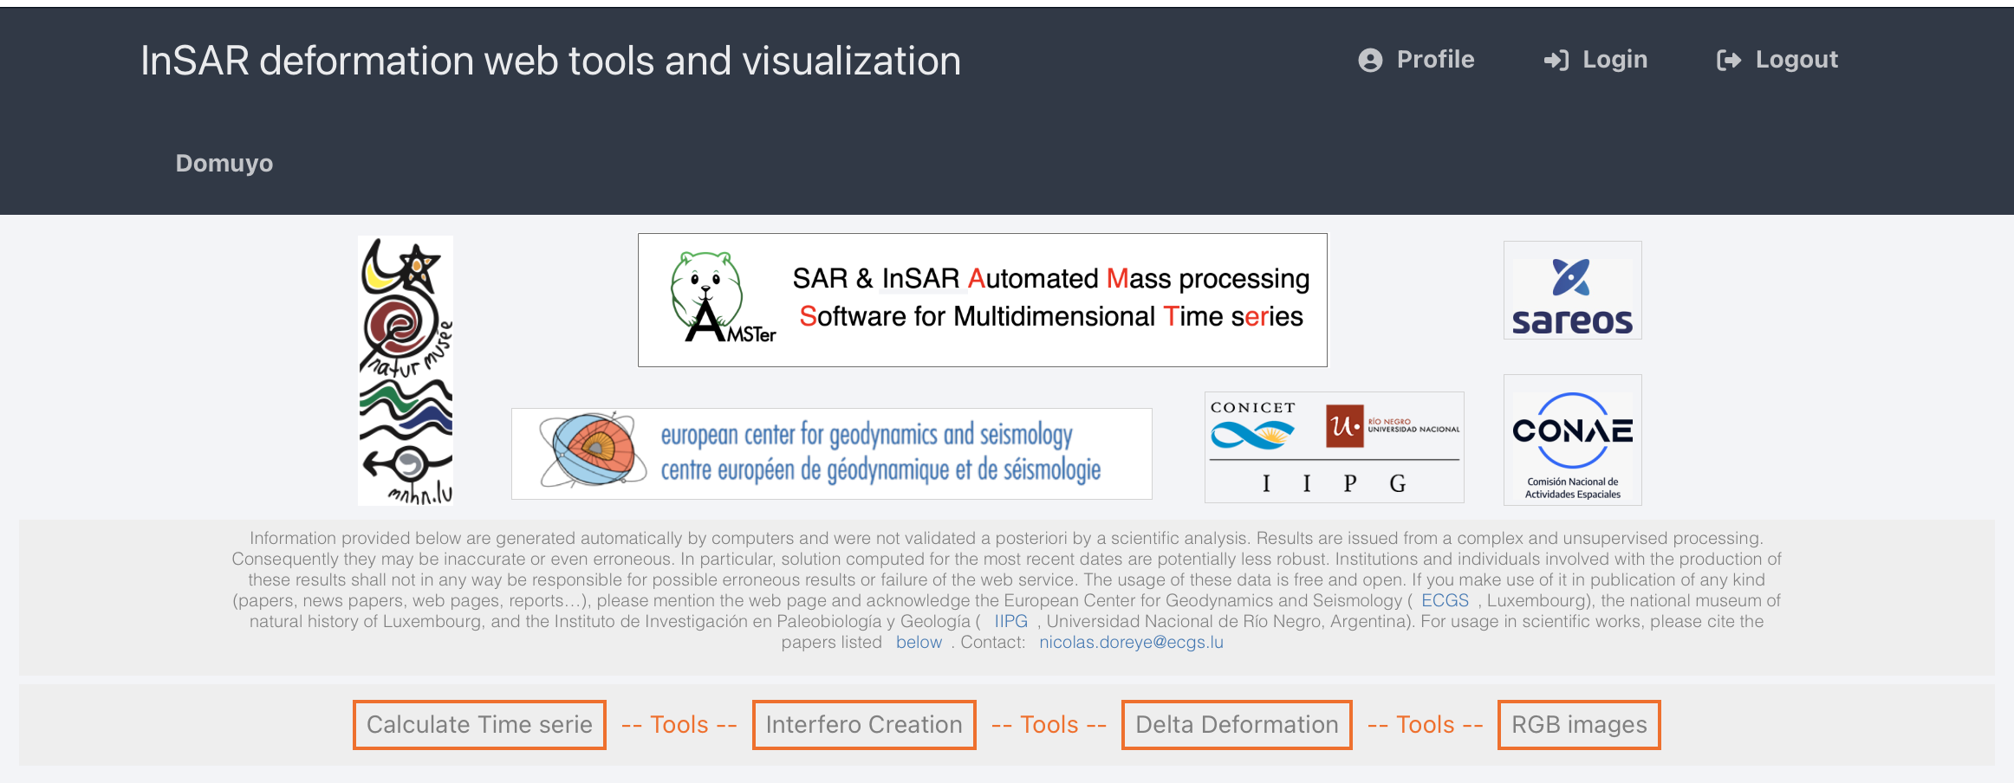
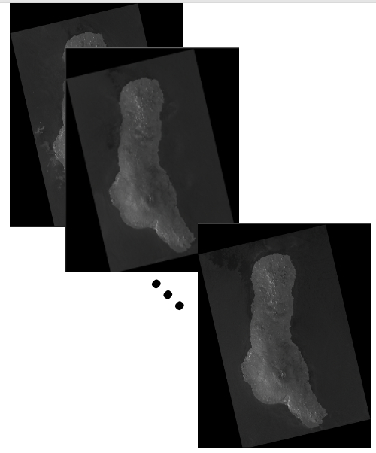
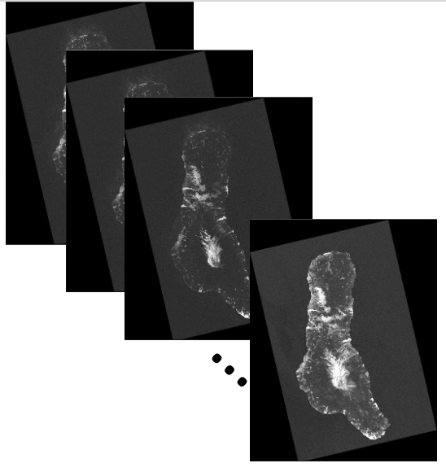
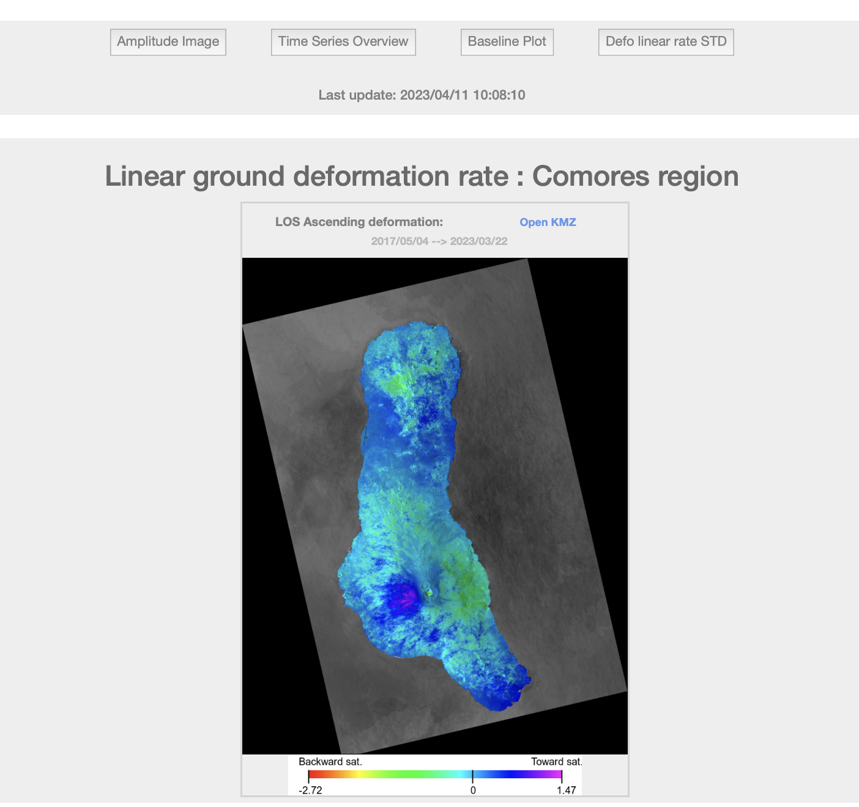
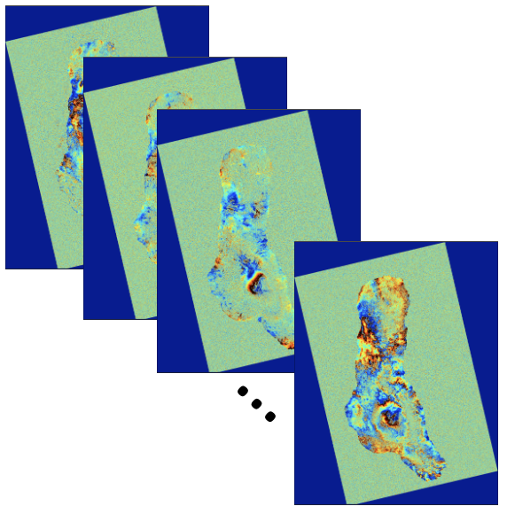
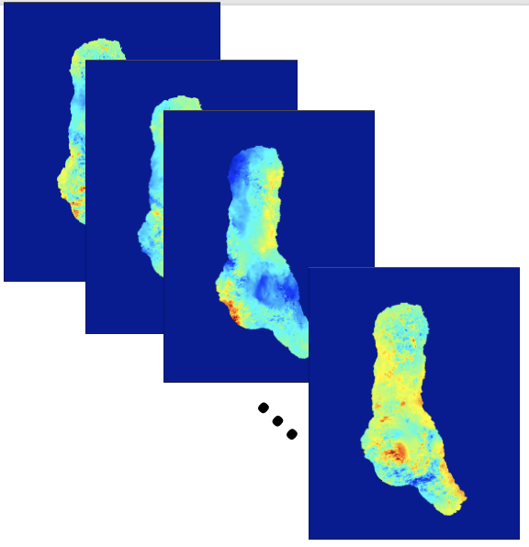
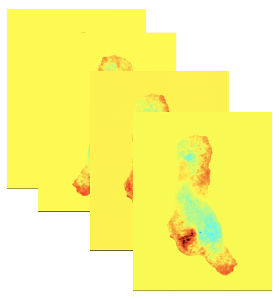
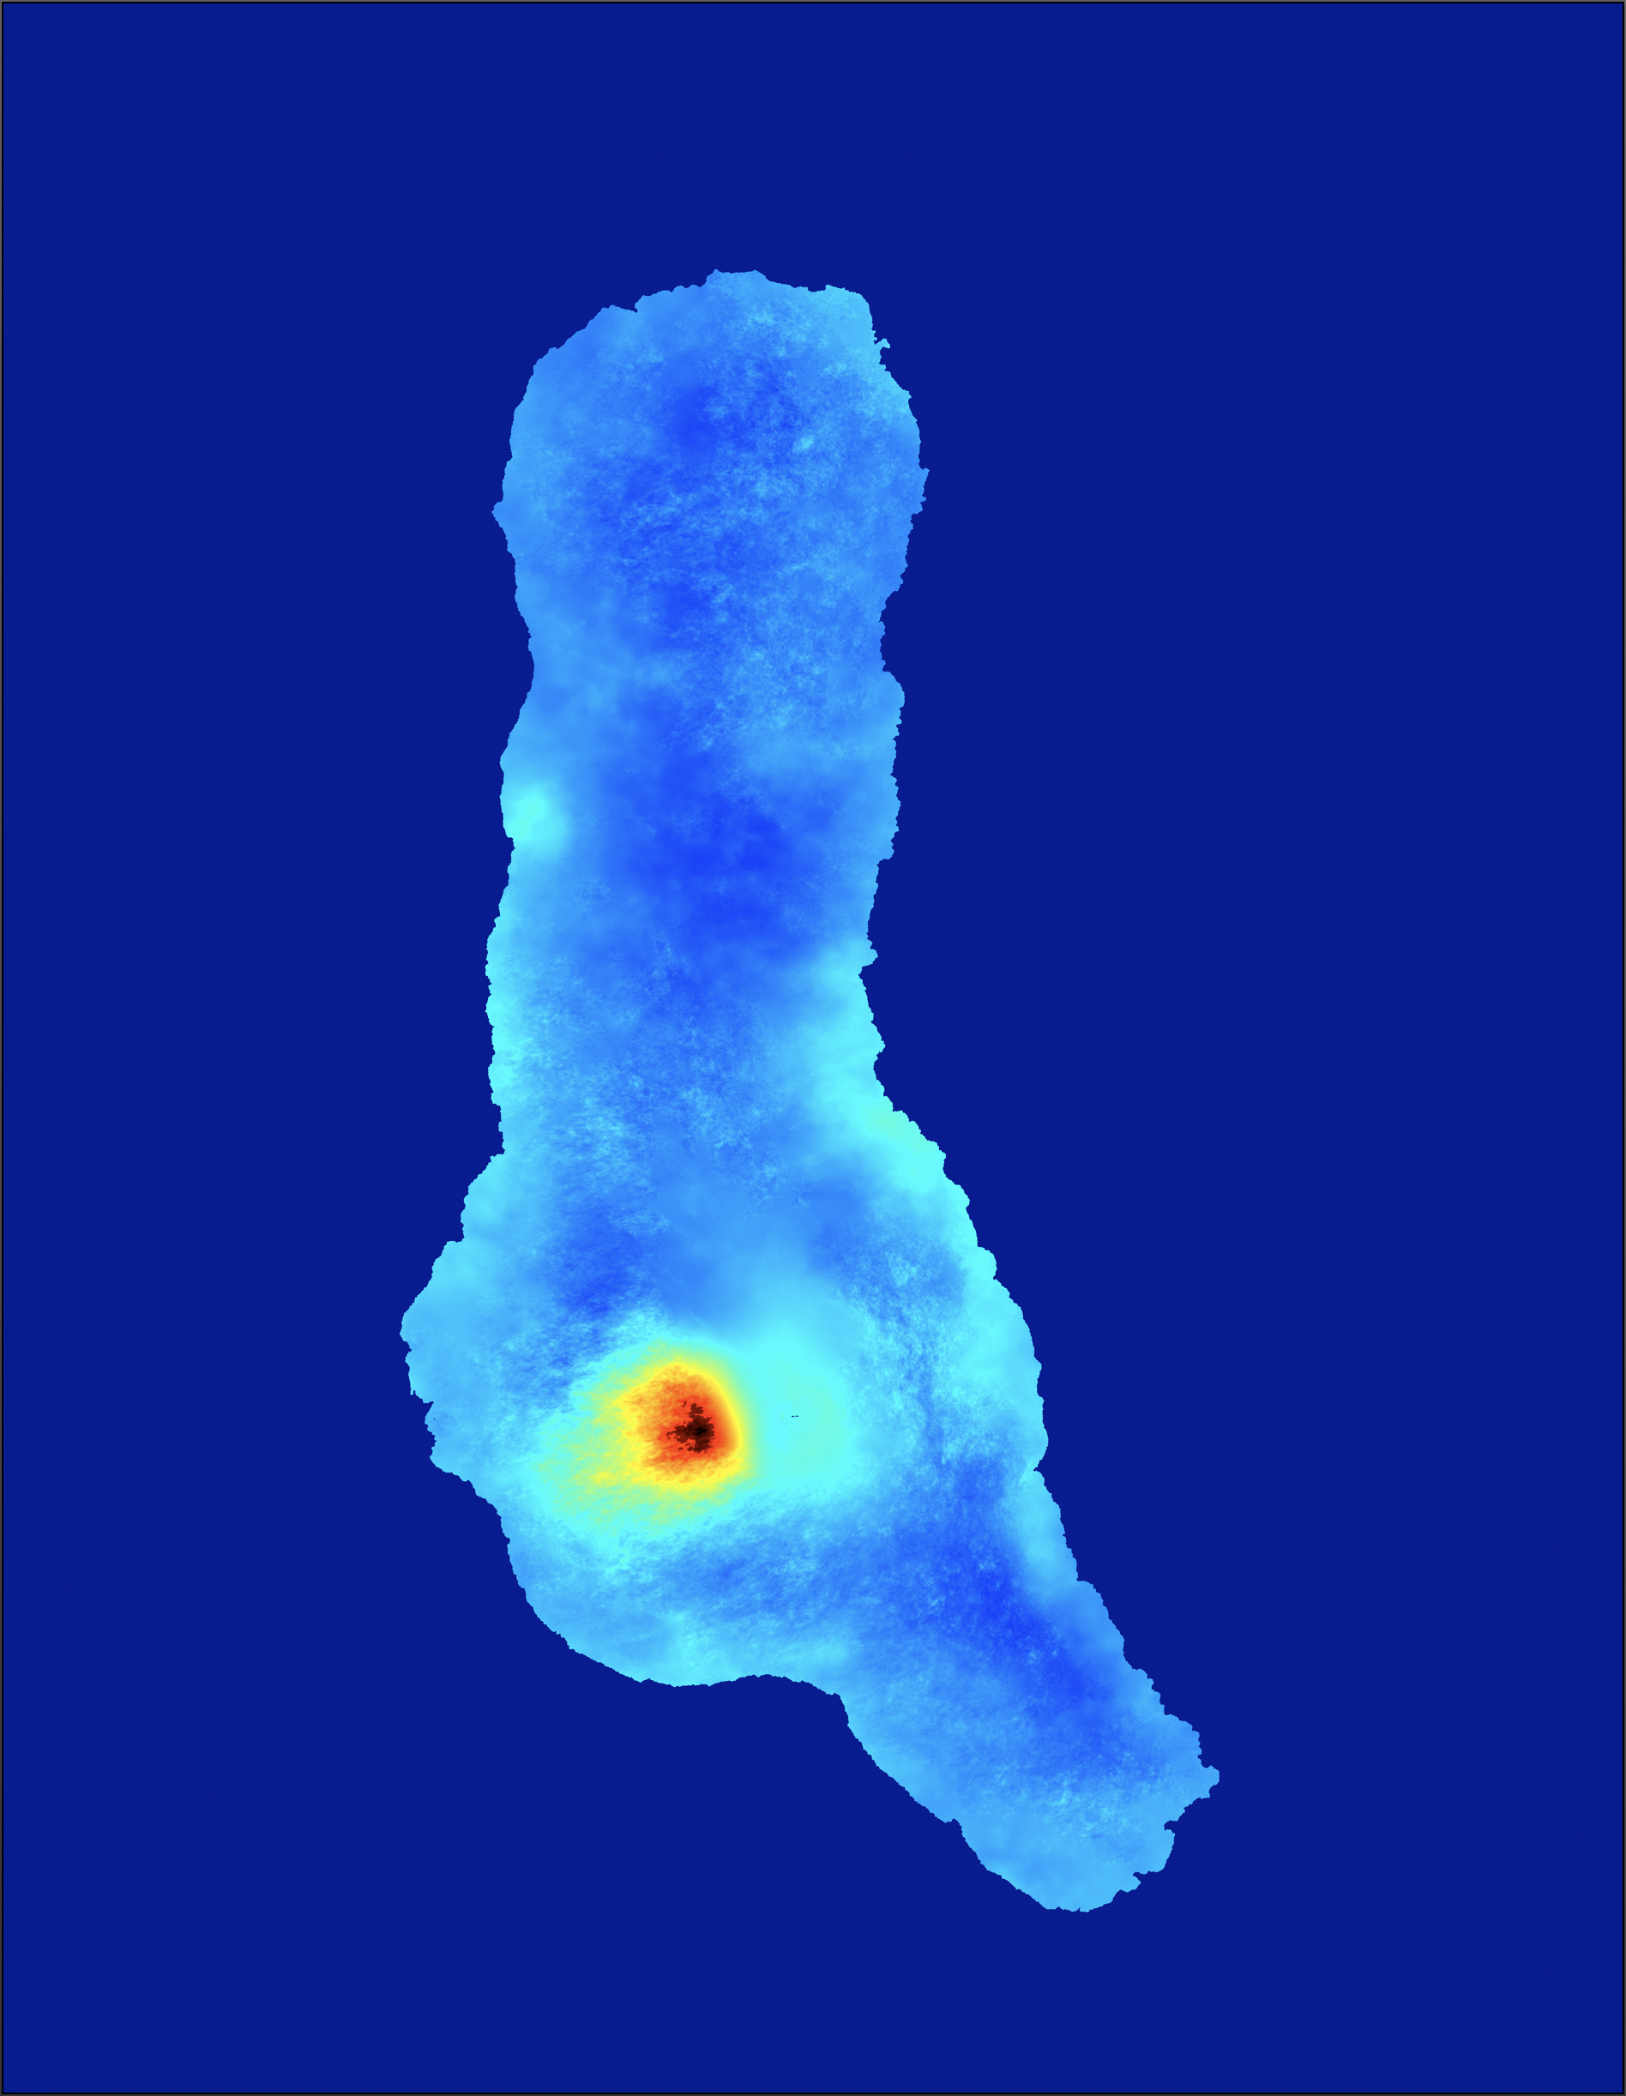
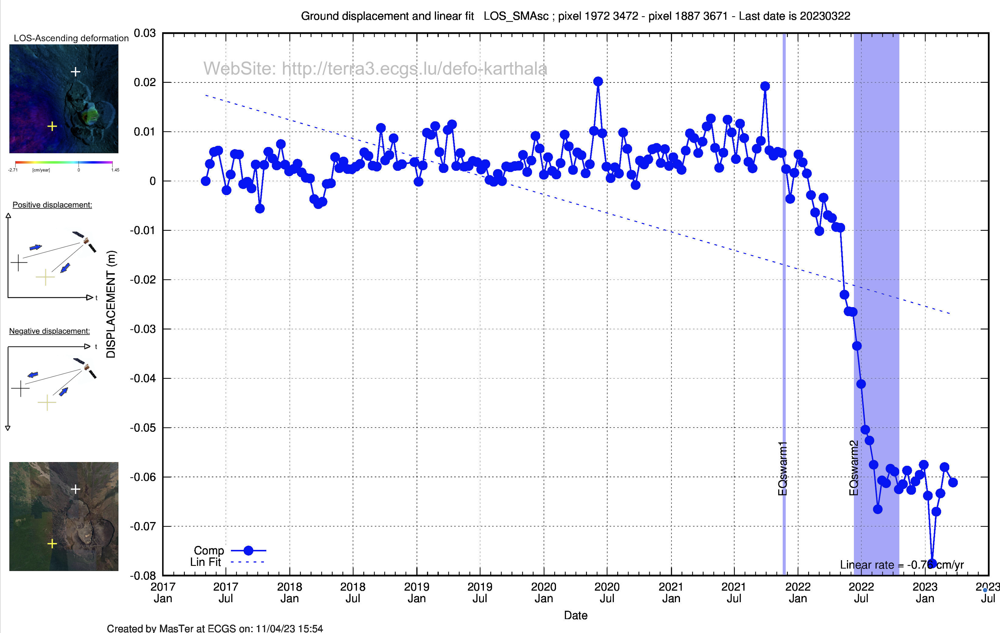
MasTer Toolbox
Sat. image
Download
Web Page(s)
Interferometric processing
(AMSTer Engine)
Ampli.
Coh.
Time Series processing
(MSBAS)
Ampli.
Defo.
Mean Veloc.
Interf.
Cumul. defo.
Defo.
Time series
G. Celli
D. Derauw
S. Samsonov
M. Jaspard
N. d’Oreye & D. Smittarello

Slide 4
Time Series plotting
Plan:
Time Series of single component: PlotTS.sh
Time Series in UD-EW component PlotTS_AllComp.sh
Insets
Error bars
Other options

Slide 5
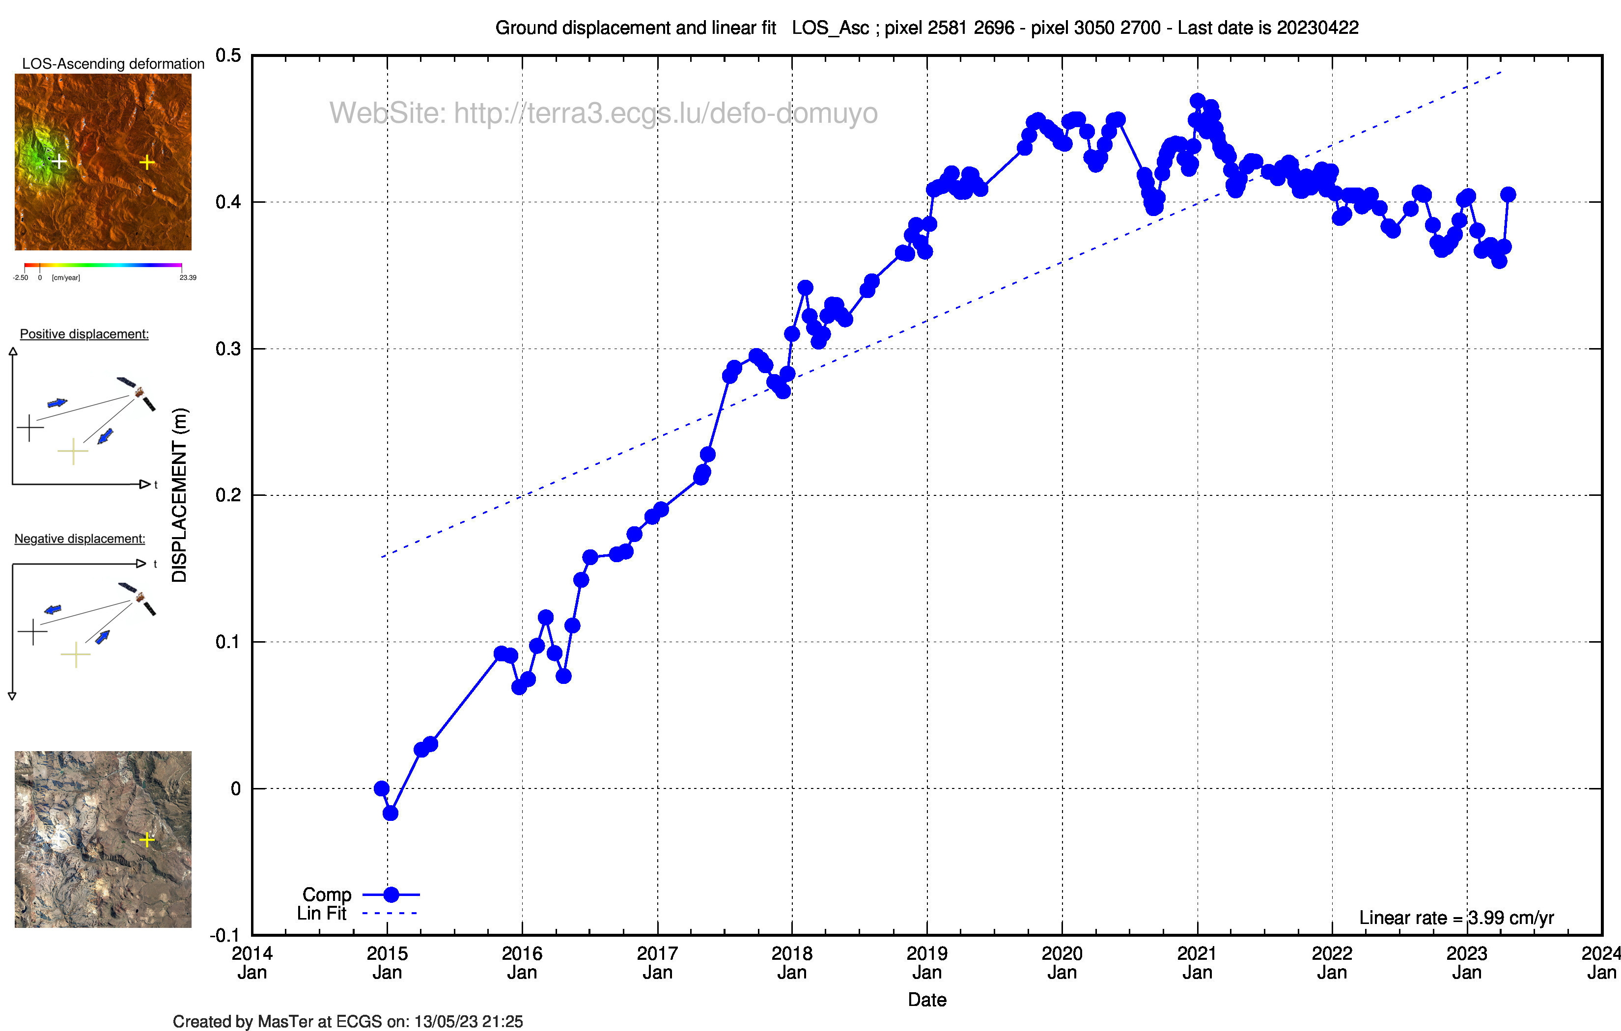
Time Series plotting
Time Series of single component: PlotTS.sh
Must be run in directory where MSBAS data of the component are, that is e.g. .../3602/MSBAS/YourRegion_and_Some_Info/zz_LOS_Asc….
Templates required: plotTS_template.gnu or plotTS_template_fit.gnu
Syntax: Needs the following parameters:
Coord. (lines and cols) of pixel(s)
Optional :
-f and –r (to display linear fit and rate)
-t (to add tag with direction of displacment)
-g, -d or –D (to clean gnu and txt files)
-EVENTS=/PathToEventsDir (see options here after)
start=YYYYMMDD -stop=YYYYMMD
Note: See hard coded lines in need to be launched from QGIS

Slide 6
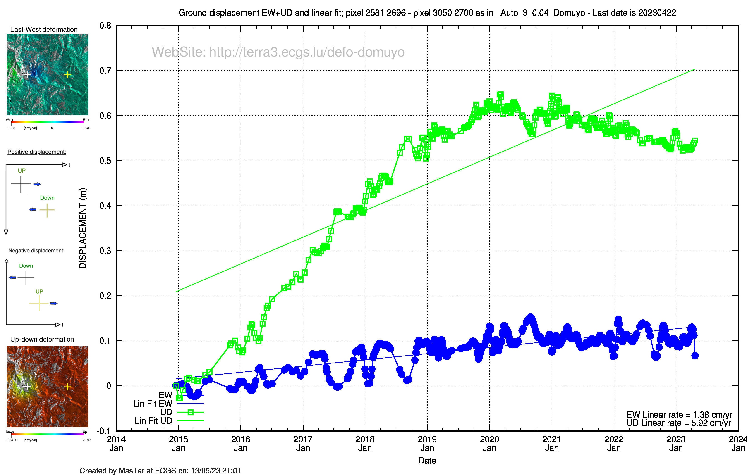
Time Series plotting
Time Series of single component: PlotTS.sh
Time Series in UD-EW component PlotTS_AllComp.sh
Must be run in directory where MSBAS data are in sub directories, that is e.g. .../3602/MSBAS/YourRegion_and_Some_Info/
Templates required: plotTS_template_multi.gnu or plotTS_template_multi_fit.gnu
Syntax: Needs the following parameters:
Remak used in dir naming of the components e.g. zz_EW_REMARKDIR
Coord. (lines and cols) of pixel(s)
Optional :
-f and –r (to display linear fit and rate)
-t (to add tag with direction of displacment)
-g, -d or –D (to clean gnu and txt files)
-EVENTS=/PathToEventsDir (see options here after)
start=YYYYMMDD -stop=YYYYMMD
Coh=Option to display error bars (see here after)

Slide 7
Time Series plotting
Time Series of single component: PlotTS.sh
Time Series in UD-EW component PlotTS_AllComp.sh
Insets
3 types of insets are displayed automatically, that is
Inset to display the pixel localisation on velocity map
Insets to display the direction of displacement
Inset to display the location on Google Earth (Single component only)
providing that the correct info are present where needed:
TS_Displ_comp.png These figs are located in /SCRIPTS_MT/TSCombiFiles They will be copied automatically in .../3602/MSBAS/YourRegion_and_Some_Info/
TS_parameters.txt located in /SCRIPTS_MT/TSCombiFiles which contains the following parameters (to be adjsued to your needs – see after)
Satview.jpg in .../3602/MSBAS/YourRegion_and_Some_Info/CombiFiles which contains the Google Earth map (see after how to prepare it). Note that its tif version might be needed for the web page (Satview.tif)

Slide 8
Time Series and maps plotting
Time Series of single component: PlotTS.sh
Time Series in UD-EW component PlotTS_AllComp.sh
Insets
TS_parameters.txt:
# Data related to HP server path
defo-domuyo # WebPage
# Fiji_Amp_Defo_Coh script and ImageCreator.sh
# Value used to build the legend of the deformation maps
1.3 # IJAmpMin (Minimum value for brightness to build amplitude image using ImageJ)
2.7 # IJAmpMax (Maximum value for brightness to build amplitude image using ImageJ)
40 # MarkUp (Legend vertical bar position Up)
90 # MarkDown (Legend vertical bar position Down)
125 # LegValPosH (Vertical Position of the value in the legend)
125 # LegUnitPosH (Vertical Position of the unity in the legend)
35 # LegTxtPosH (Vertical Position of the text info in the legend)
8 # LegAdjZero (Fine adjustment of the horizontal positionnement of Zero)
60 # LegAdjMin (Fine adjustment of the horizontal positionnement of Min Val)
10 # LegAdjMax (Fine adjustment of the horizontal positionnement of Max Val)
70 # LegAdjLOS (Fine adjustment of the horizontal positionnement of Max Val for LOS maps)
200 # LegAdjUnit (Fine adjustment of the horizontal positionnement of Unity related to the left)
[…]
This first part of TS_parameters.txt usually doesn’t need to be changed

Slide 9
Time Series plotting
Time Series of single component: PlotTS.sh
Time Series in UD-EW component PlotTS_AllComp.sh
Insets
TS_parameters.txt: review the parameters in red:
# CreateColorFrame script + Fiji_Amp_Defo_Coh script
100 # Margin
800 # LegendWidth
0.6 # ColorBackgrdLegnd (0 = white --> 1 = grey)
35 # LegendTxtSize (Size of the text in the legend)
140 # LegendHeight (Height of the legend in pixels margin include)
40 # FrameTop (distance between top of color frame and top of the legend)
60 # FrameBott (distance between bottom of color frame and top of the legend)
# ImageCreator.sh and TimeSeriesInfo.sh
1000 # Crop_X (Top left X coordinate of the cropped zone)
1000 # Crop_Y (Top left Y coordinate of the cropped zone)
3361 # Crop_L (Horizontal size of the cropped zone)
2800 # Crop_H (Vertical size of the cropped zone)
# TimeSeriesInfo.sh
100 # CrossTresh (Distance between 2 points (Vert or Horiz) which determine the size of the cross)
15 # CrossBig Size of the cross in defo map as thumbnail if spacement between 2 pts are > treshold)
15 # CrossSmall Size of the cross in defo map as thumbnail if spacement between 2 pts are < treshold)
2.5 # RateResoSatView (Rate of pixels number compare with envi files)
⬅ Depends on the size of your full image
⬅ Needs explanation !

Slide 10
Time Series plotting
Time Series of single component: PlotTS.sh
Time Series in UD-EW component PlotTS_AllComp.sh
Insets
How set the RateResoSatView param for TS_parameters.txt ?
How create the Satview.tiff (and terrain.tif – for web page) (See also manual Web_tool_Vx.x.docx)
Open a Google Earth background in QGIS as layer 1
Import a product map (defo, coh….) with the size of the msbas products as layer 2
Right-click on layer1 and select ‘Export – >save as’ with following option:
Output mode = Raw data
Format = Geotiff
Disable ‘Create VRT’ (untick the box to the right of “Format” box)
Change the CRS manually as the one of layer2 (You can find it in hdr file of layer2)
In extend, click on “Layer” and select layer2 (envi file).
in the “Horizontal” and “Vertical” boxes, enter the layer resolution factor to get image size of layer 1 (in lines/col) e.g. 5 time larger than of layer 2. Try e.g. entering a factor 10 or 50 and see the lines and col sizes in boxes “Columns” and “Rows”.

Slide 11
Time Series plotting
Time Series of single component: PlotTS.sh
Time Series in UD-EW component PlotTS_AllComp.sh
Insets
How set the RateResoSatView param for TS_parameters.txt ?
How create the Satview.tiff (and terrain.tif – for web page) (See also manual Web_tool_Vx.x.docx)
Save your file in .../3602/MSBAS/YourRegion_and_Some_Info/CombiFiles as satview.tif (for the web page, you may want to do the same with Google terrain and save it as terrain.tif)
Convert it as jpg using convert: convert satview.tif satview.jpg
Edit the TS_parameters.txt to set:
The “RateResolutionFactor” (The RateResolutionFactor to write in TS_parameters.txt , is the size (either the number of lines or columns) of the layer 1 jpg image divided by the size of the MSBAS products)
The size/crop of the msbas products
# ImageCreator.sh and TimeSeriesInfo.sh
1000 # Crop_X (Top left X coordinate of the cropped zone)
1000 # Crop_Y (Top left Y coordinate of the cropped zone)
3361 # Crop_L (Horizontal size of the cropped zone)
2800 # Crop_H (Vertical size of the cropped zone)
[...]
2.5 # RateResoSatView (Rate of pixels number compare with envi files)

Slide 12
Time Series plotting
Time Series of single component: PlotTS.sh
Time Series in UD-EW component PlotTS_AllComp.sh
Insets
Error bars
2 types of error bars plots are possible:
During operation of msbas: cfr list of points, e.g. Points_TS_Domuyo.txt
Figures are stored in pdf format in .../3602/MSBAS/YourRegion_and_Some_Info/zz_UD_EW_TS_...
Error bars = stdv among values of pixels in a box of + radiusX and + radiusY around the pixel.
name x y radiusX raduisY
LagunaMaule_Summit 2357 1443 0 0
LagunaMaule_W 1653 1443 3 3
LagunaMaule_S 2357 2146 3 3
LagunaFea_1 2494 1698 0 0
LagunaFea_2 2515 1685 3 3

Slide 13
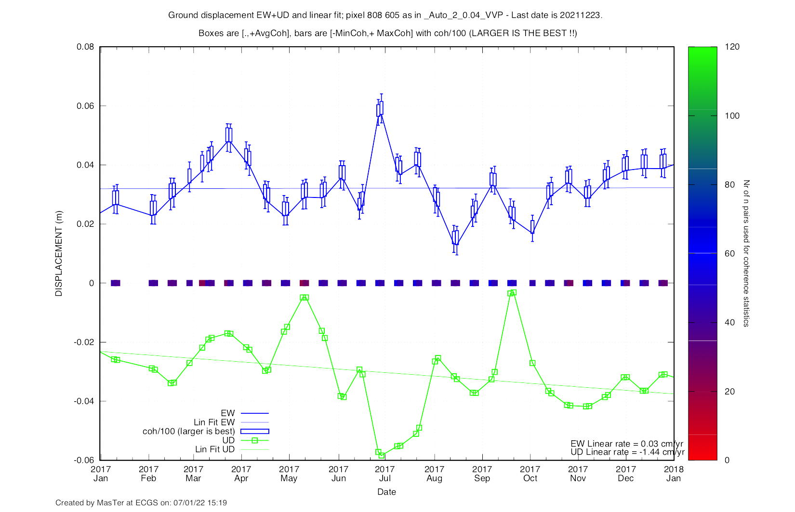
Time Series plotting
Time Series of single component: PlotTS.sh
Time Series in UD-EW component PlotTS_AllComp.sh
Insets
Error bars
2 types of error bars plots are possible:
After msbas processing, with PlotTS_AllComp.sh with option (See manual § 6.4b) -coh=avgavg, avgmin, avgminmax or avgavgminmax
The script computes the mean coherence (avg), min and max coherence (/100 !).
Note that because these boxes and bars are coherence related info and not “error bars”, the larger is the best!.
Color-coded symbols are added along the y=0 axis corresponding to the number of pairs used to compute the coherence statistics.
Figures are stored in eps format on single pixel plots in .../3602/MSBAS/YourRegion_and_Some_Info/zz_UD_EW_TS_...
Example of plot with option -coh=avgminmax. Bottom of the box is displacement, top of the box is the average coherence (/100). Lower and upper bars are min and max coherence (/100) respectively.

Slide 14
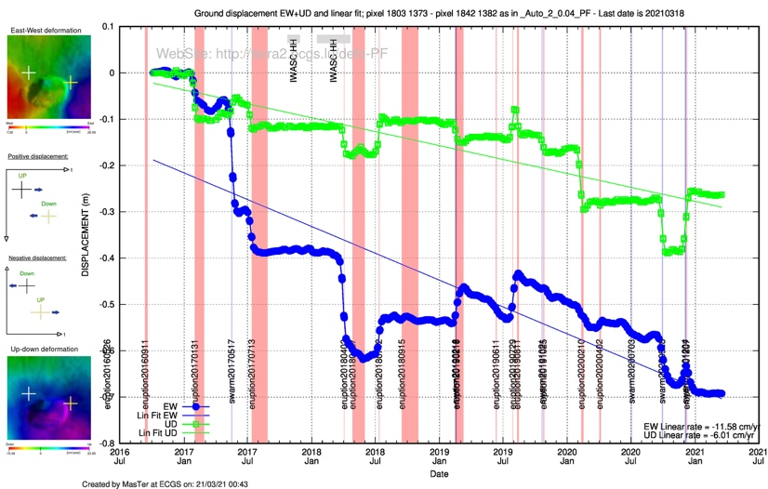
Time Series plotting
Time Series of single component: PlotTS.sh
Time Series in UD-EW component PlotTS_AllComp.sh
Insets
Error bars
Other options
By providing the path to a directory (-EVENTS=/PathTo/EVENTS_TABLES)
that contains some formatted files, one can plots additional features:
EQ_YourPlace.txt: (vertical blue dashed line) e.g. EQplace yyyymmdd
EQ_Swarms_YourPlace.txt: (vertical blue rectangle) e.g. EQplace yyyymmdd yyyymmdd
Eruptions_YourPlace.txt: (vertical red rectangle) e.g. ErVolc yyyymmdd yyyymmdd
Sat_Cover_YourPlace.txt: (horiz. blue and/or red rectangles) e.g. Sat_Mode yyyymmdd yyyymmdd
Asymetric_Acquisition_YourPlace.txt: (horiz. grey rectangles) e.g. Desc-Only yyyymmdd yyyymmdd
Other_events_YourPlace.txt: (vertical blue dashed line) e.g. Name yyyymmdd
May need to change gnu scripts to adjust position of tags etc…
Events tables must contain names and dates in columns separated by a single tab. No empty lines in the files or at the bottom.

Slide 15
Time Series plotting
Plan:
Time Series of single component: PlotTS.sh
Time Series in UD-EW component PlotTS_AllComp.sh
Insets
Error bars
Other options
- DONE ! -

